Slide 1
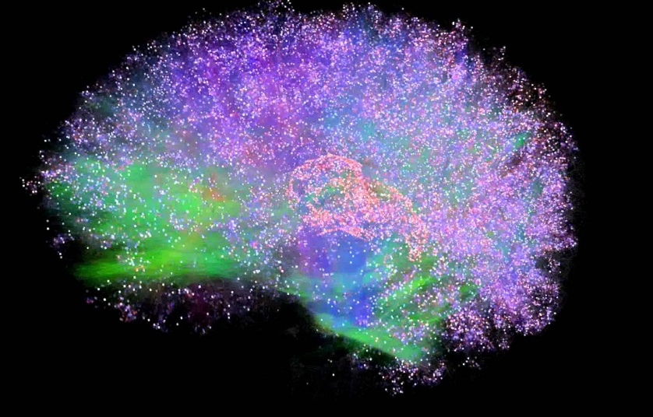
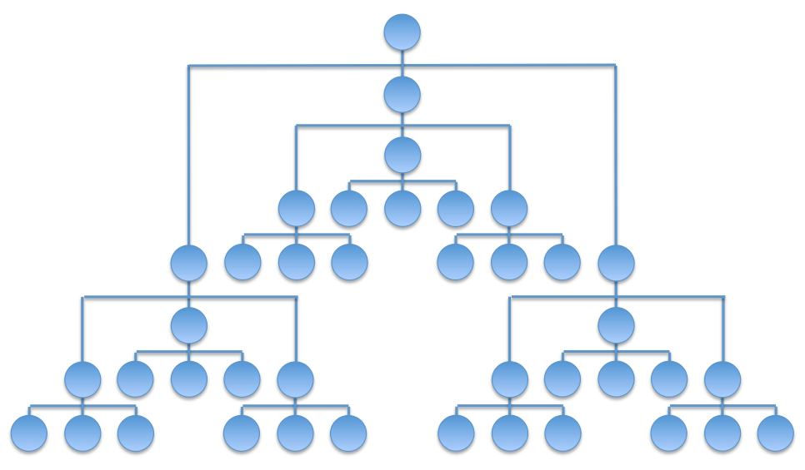
Integrated Information Theory for Organisational Consciousness
Jonathan Peters
Supervisors: Mariano Beguerisse, Christian Bick, Yakov Kremnitzer, Steve Brewis, Steve Cassidy

Slide 2

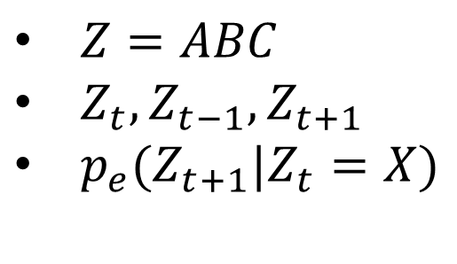

Notation
A
Or
$Z=ABC$
$Z_{t},Z_{t−1},Z_{t+1}$
$p_{e}(Z_{t+1}|Z_{t}=X)$
B AND
C
XOR
We can also compute repertoires for subsets of the system:
$$p({AB}_{t+1}|{BC}_{t}=01)$$
For example,
$$p(Z_{t+1}|Z_{t}=100)$$

Slide 3

Transition Probability Matrix
$$T_{ij}=P(Z_{t+1}=j|Z_{t}=i)$$
ABC | 000 | 100 | 010 | 110 | 001 | 101 | 011 | 111
000 | 1 | 0 | 0 | 0 | 0 | 0 | 0 | 0
100 | 0 | 0 | 0 | 0 | 1 | 0 | 0 | 0
010 | 0 | 0 | 0 | 0 | 0 | 1 | 0 | 0
110 | 0 | 1 | 0 | 0 | 0 | 0 | 0 | 0
001 | 0 | 1 | 0 | 0 | 0 | 0 | 0 | 0
101 | 0 | 0 | 0 | 0 | 0 | 0 | 0 | 1
011 | 0 | 0 | 0 | 0 | 0 | 1 | 0 | 0
111 | 0 | 0 | 0 | 1 | 0 | 0 | 0 | 0

Slide 4
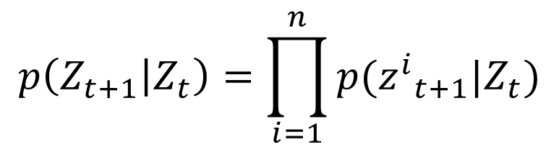

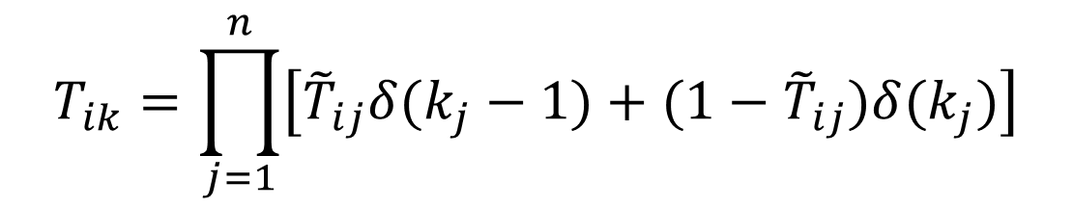
Conditional Independence
State | A | B | C
000 | 0 | 0 | 0
100 | 0 | 0 | 1
010 | 1 | 0 | 1
110 | 1 | 0 | 0
001 | 1 | 0 | 0
101 | 1 | 1 | 1
011 | 1 | 0 | 1
111 | 1 | 1 | 0
$$p\left(Z_{t+1} | Z_{t}\right)=\prod_{i=1}^{n}{p({z^{i}}_{t+1}|Z_{t})}$$
$${\tilde{T}}_{ij}=P({z^{i}}_{t+1}=1|Z_{t}=i)$$
$$T_{ik}=\prod_{j=1}^{n}{\left[{\tilde{T}}_{ij}δ(k_{j}−1)+(1−{\tilde{T}}_{ij})δ(k_{j})\right]}$$

Slide 5
Mechanisms
A Or
B And
C Xor
Existence: The mechanism ABC exists.
Composition: The mechanism ABC is the composition of 3 smaller mechanisms: a 3rd order mechanism.

Slide 6
Information
Unconstrained Present
Known Present State
Unconstrained Future
Effect Repertoire
$$ei\left(Z_{t}=X\right)=D\left(p_{e}\left(Z_{t+1} | Z_{t}=X\right)|| p_{e}\left(Z_{t+1}|∅\right)\right)$$

Slide 7
Integration
A
A
A
A
B
B
VS
B
B
C
C
C
C
$${φ^{M,N}}_{effect}\left(Z_{t}=X,Z_{t+1}\right)=D\left(p_{e}\left(Z_{t+1} | Z_{t}=X\right)||p_{e}\left(N_{t+1} | M_{t}\right)∗p_{e}\left({Z\backslash N}_{t+1} | {Z\backslash M}_{t}\right)\right)$$
$${φ^{MIP}}_{effect}\left(Z_{t}=X,Z_{t+1}\right)=\min_{N,M∈P(G)}{{φ^{M,N}}_{effect}\left(Z_{t}=X,Z_{t+1}\right)}$$

Slide 8

Exclusion
What is the core effect of ${AB}^{c}=01$?
A
A
B
B
C
C
Calculate${φ^{MIP}}_{effect}\left({AB}_{t}=01, M\right)$ for all $M∈P(G)$
The largest value gives ${φ^{Max}}_{effect}\left({AB}_{t}=01\right)$

Slide 9
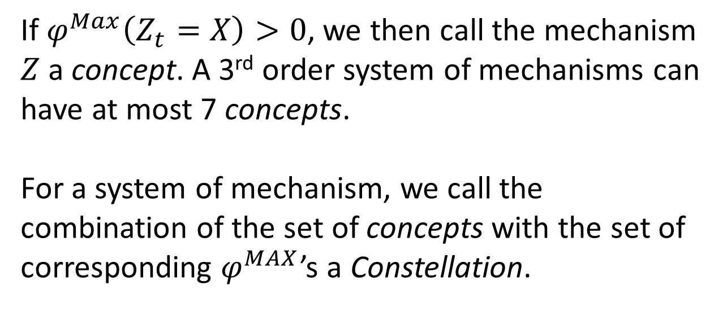
Further Calculations
If $φ^{Max}\left(Z_{t}=X\right)>0$, we then call the mechanism $Z$ a concept. A 3rd order system of mechanisms can have at most 7 concepts.
For a system of mechanism, we call the combination of the set of concepts with the set of corresponding $φ^{MAX}$’s a Constellation.

Slide 10
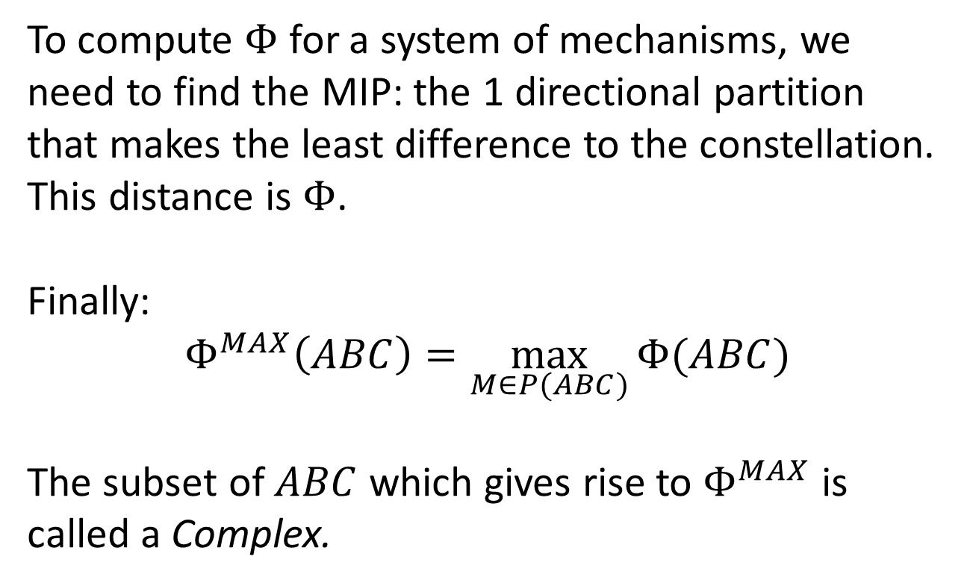
Further Calculations
To compute $Φ$ for a system of mechanisms, we need to find the MIP: the 1 directional partition that makes the least difference to the constellation. This distance is $Φ$.
Finally:
$$Φ^{MAX}\left(ABC\right)=\max_{M∈P(ABC)}{Φ(ABC)}$$
The subset of $ABC$ which gives rise to $Φ^{MAX}$ is called a Complex.

Slide 11
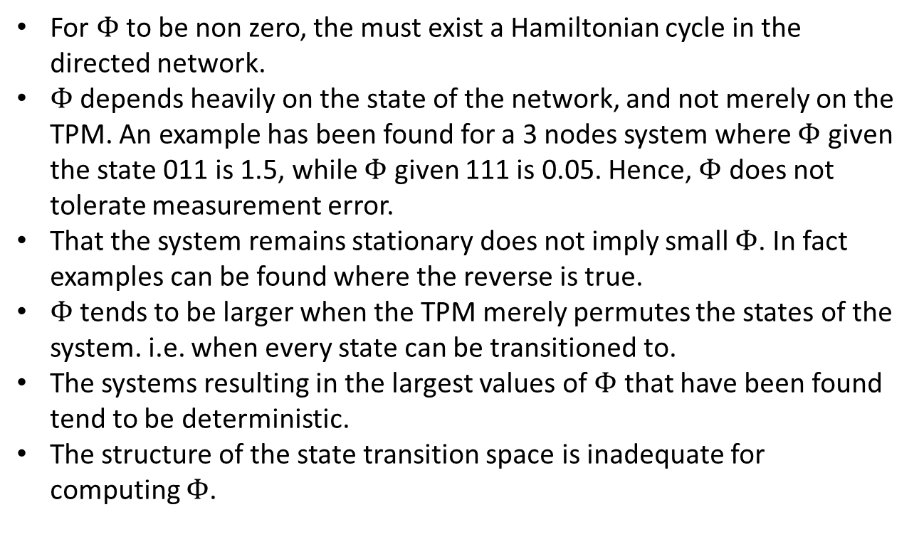
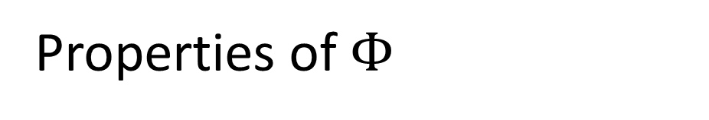
Properties of $Φ$
For $Φ$ to be non zero, the must exist a Hamiltonian cycle in the directed network.
$Φ$ depends heavily on the state of the network, and not merely on the TPM. An example has been found for a 3 nodes system where $Φ$ given the state 011 is 1.5, while $Φ$ given 111 is 0.05. Hence, $Φ$ does not tolerate measurement error.
That the system remains stationary does not imply small $Φ$. In fact examples can be found where the reverse is true.
$Φ$ tends to be larger when the TPM merely permutes the states of the system. i.e. when every state can be transitioned to.
The systems resulting in the largest values of $Φ$ that have been found tend to be deterministic.
The structure of the state transition space is inadequate for computing $Φ$.

Slide 12
Model
Properties of the Organisation
Profits are made by completing projects. These projects require the application of certain skills in order to be completed.
Each team/individual within the company possesses at least one skill. Projects are completed as teams with sufficient skills are assigned to projects.
Teams act as if the only other existing teams are the ones which they are ‘paying attention to’.
Teams assign themselves to projects if they are furthering the organisations goals by doing so as far as the team is aware.

Slide 13
Model
Goals of the Organisation
The objective of the organisation is to minimize waste.
3 types of waste exist:
Neglect of a doable project.
Duplication of labour.
Overqualified labour.
A, α
αβ
B, β
A, α
A, αβ
α
α
B, α

Slide 14
Model
Available Teams
α
β
αγ
βγ
How should these teams be connected?
αβ

Slide 15
Solving the Model
Two solutions of interest:
Classical solution: for a given connectivity matrix, how much waste do we expect?
IIT: how much ‘integrated information’ does this system possess?
Is there a correlation between these two measures?

Slide 16
Implementation
A team will take up a project if:
They cannot see an idle team which is more qualified.
They possess a required skill
If they can do the project solo, this is sufficient.
Else, they must be strongly connected to another team which has the remaining skills, and is also idle.

Slide 17
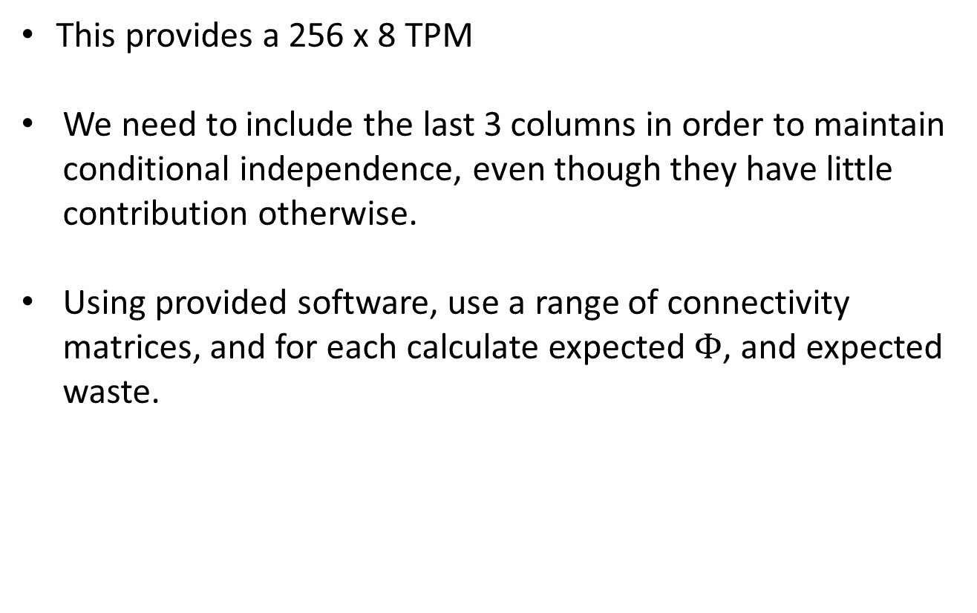
Implementation
This provides a 256 x 8 TPM
We need to include the last 3 columns in order to maintain conditional independence, even though they have little contribution otherwise.
Using provided software, use a range of connectivity matrices, and for each calculate expected $Φ$, and expected waste.

Slide 18
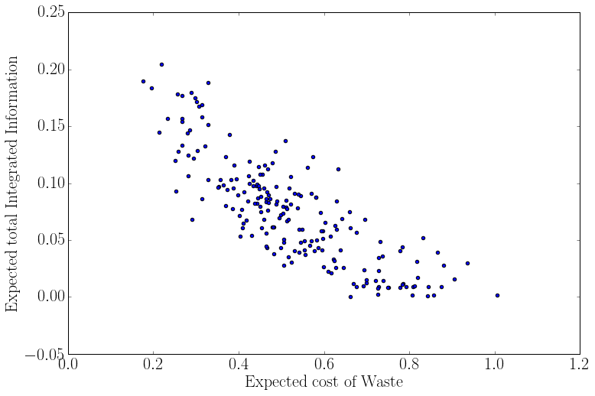
Results

Slide 19
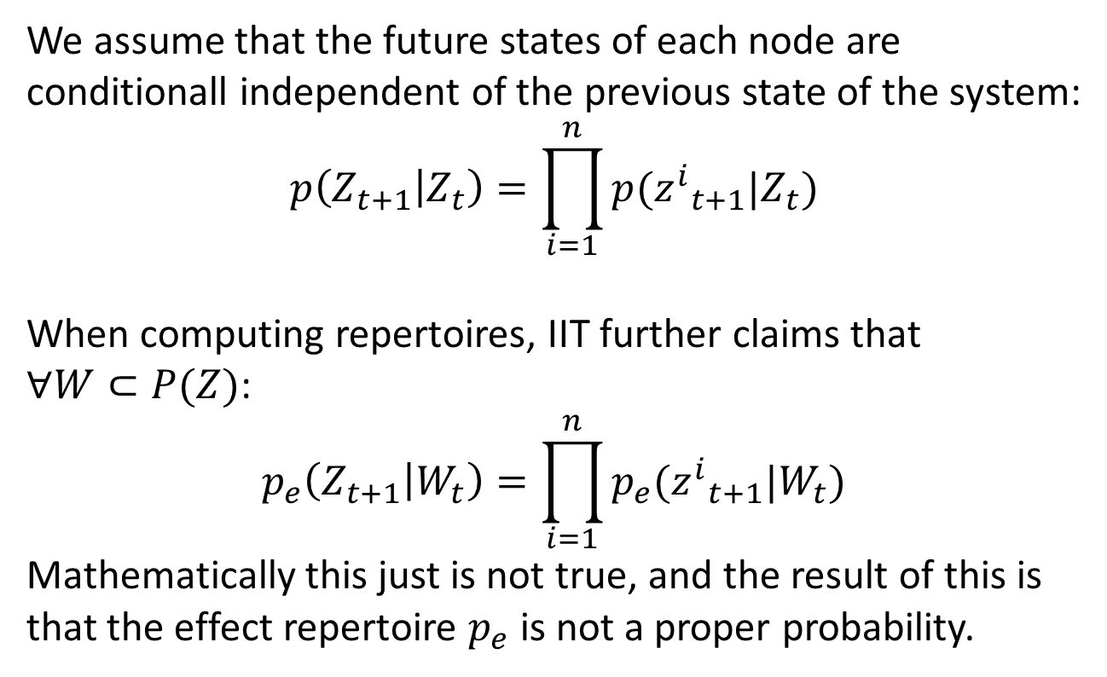
Repertoires vs Probability
We assume that the future states of each node are conditionall independent of the previous state of the system:
$$p\left(Z_{t+1} | Z_{t}\right)=\prod_{i=1}^{n}{p({z^{i}}_{t+1}|Z_{t})}$$
When computing repertoires, IIT further claims that $∀W⊂P(Z)$:
$$p_{e}\left(Z_{t+1} | W_{t}\right)=\prod_{i=1}^{n}{p_{e}({z^{i}}_{t+1}|W_{t})}$$
Mathematically this just is not true, and the result of this is that the effect repertoire $p_{e}$ is not a proper probability.

Slide 20
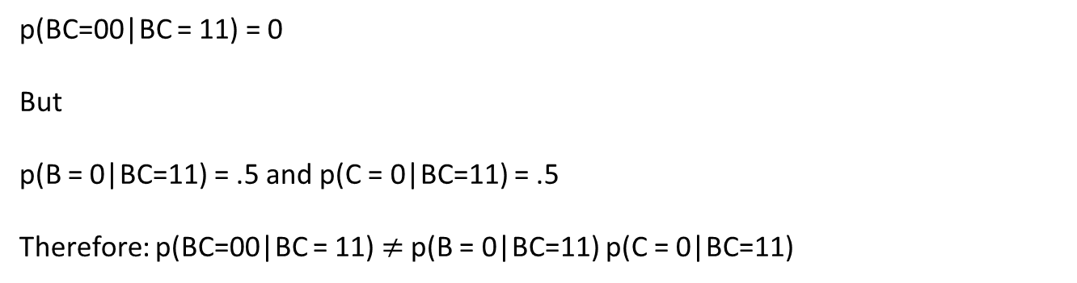
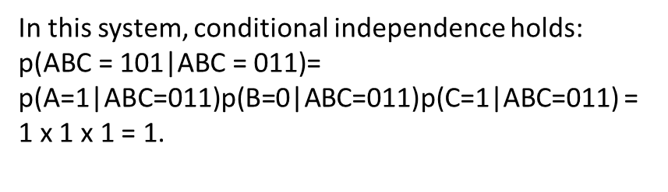
Repertoires vs Probability
A
Or
State | A | B | C
000 | 0 | 0 | 0
100 | 0 | 0 | 1
010 | 1 | 0 | 1
110 | 1 | 0 | 0
001 | 1 | 0 | 0
101 | 1 | 1 | 1
011 | 1 | 0 | 1
111 | 1 | 1 | 0
B AND
C
XOR
In this system, conditional independence holds:
$\text{p}\text{(}\text{ABC}\text{ = 101|}\text{ABC}\text{ = 011)}$= p(A=1|ABC=011)p(B=0|ABC=011)p(C=1|ABC=011) =
1 x 1 x 1 = 1.
p(BC=00|BC = 11) = 0
But
p(B = 0|BC=11) = .5 and p(C = 0|BC=11) = .5
Therefore: p(BC=00|BC = 11) $≠$p(B = 0|BC=11) p(C = 0|BC=11)

Slide 21
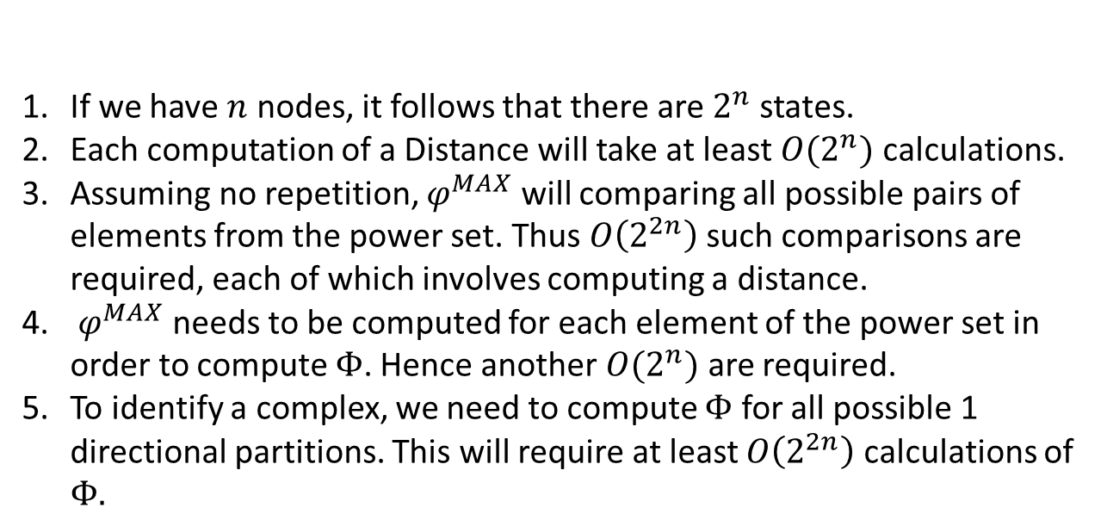
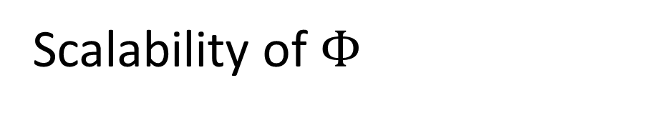
Scalability of $Φ$
If we have $n$ nodes, it follows that there are $2^{n}$ states.
Each computation of a Distance will take at least $O(2^{n})$ calculations.
Assuming no repetition, $φ^{MAX}$ will comparing all possible pairs of elements from the power set. Thus $O\left(2^{2n}\right)$ such comparisons are required, each of which involves computing a distance.
$φ^{MAX}$ needs to be computed for each element of the power set in order to compute $Φ$. Hence another $O(2^{n})$ are required.
To identify a complex, we need to compute $Φ$ for all possible 1 directional partitions. This will require at least $O\left(2^{2n}\right)$ calculations of $Φ.$
Hence we estimate $Φ$ scales with at least $O\left(2^{6n}\right)$.

Slide 22
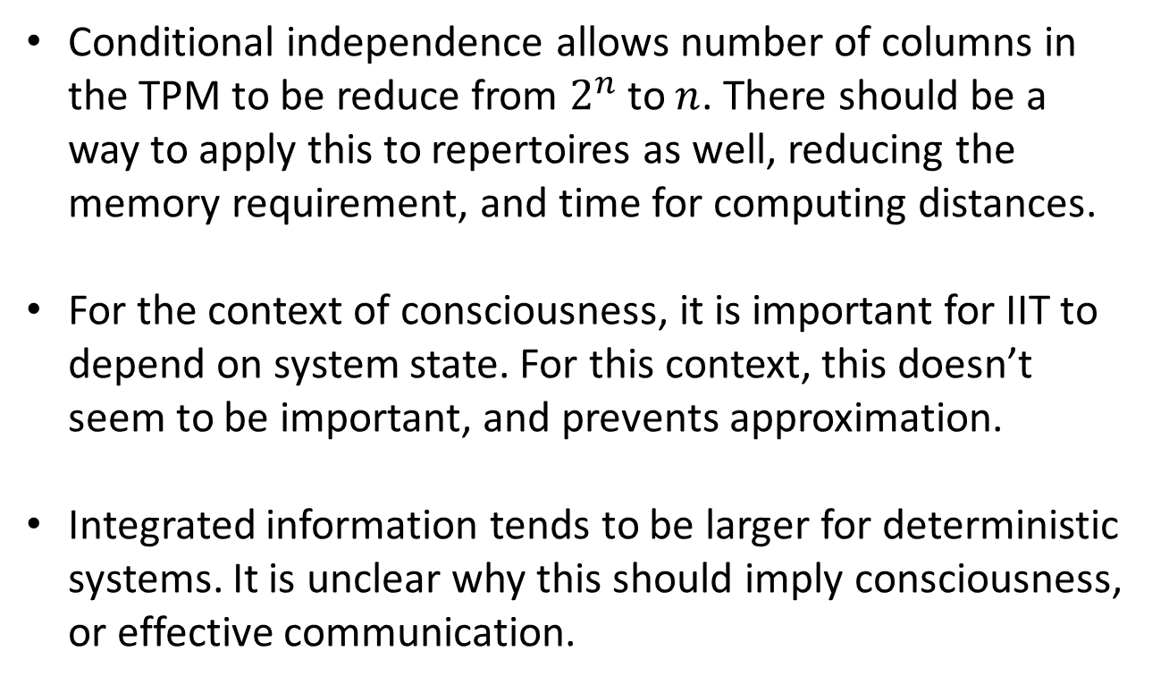
Comments on IIT
Conditional independence allows number of columns in the TPM to be reduce from $2^{n}$ to $n$. There should be a way to apply this to repertoires as well, reducing the memory requirement, and time for computing distances.
For the context of consciousness, it is important for IIT to depend on system state. For this context, this doesn’t seem to be important, and prevents approximation.
Integrated information tends to be larger for deterministic systems. It is unclear why this should imply consciousness, or effective communication.

Slide 23
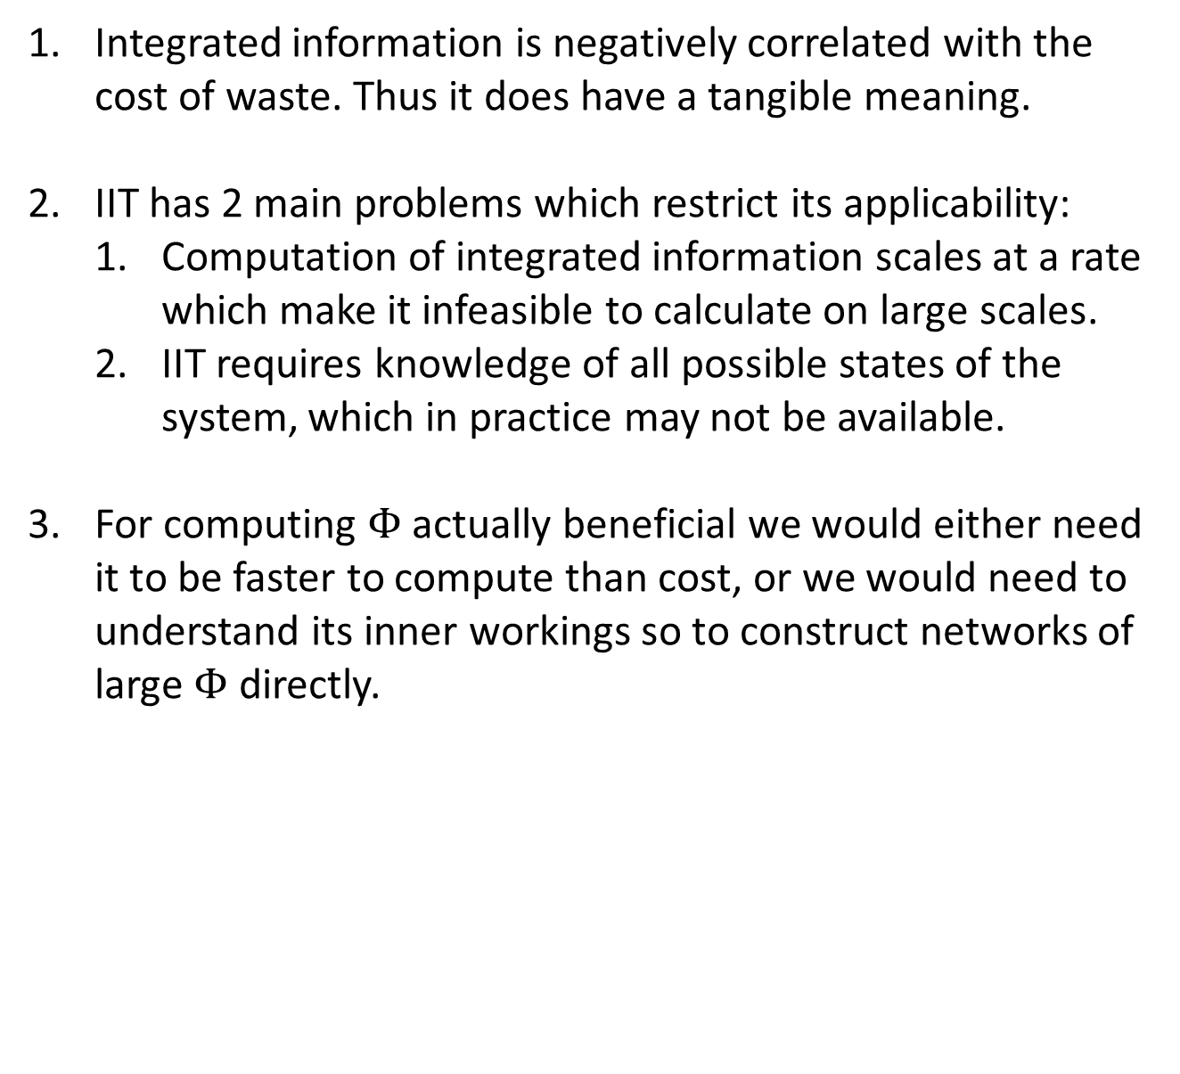
Conclusions
Integrated information is negatively correlated with the cost of waste. Thus it does have a tangible meaning.
IIT has 2 main problems which restrict its applicability:
Computation of integrated information scales at a rate which make it infeasible to calculate on large scales.
IIT requires knowledge of all possible states of the system, which in practice may not be available.
For computing $Φ$ actually beneficial we would either need it to be faster to compute than cost, or we would need to understand its inner workings so to construct networks of large $Φ$ directly.

Slide 24
Potential Extensions
Adjustment of IIT
Development of Model
Compare results of computing conditional probability instead of effect repertoire.
Investigate whether the ‘cause’ component is important for this problem.
Reduce repertoire’s to their probability generators, so to speed up distance computation.
Trial partition approximation methods for potential speedup.
Derive a more elegant localized project assignment procedure.
Experiment with varying parameters as well as connections.
Assign costs to connections, so as to find a global optimum.
Derive a better project completion mechanism.

